Slide 1
Diffusion Map
林思涵
2021/05/11

Slide 2
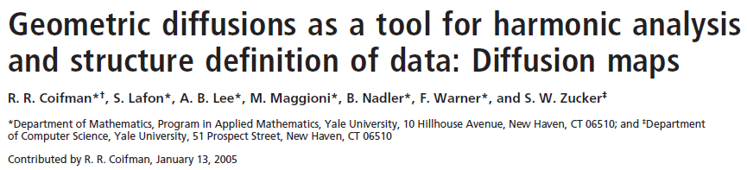
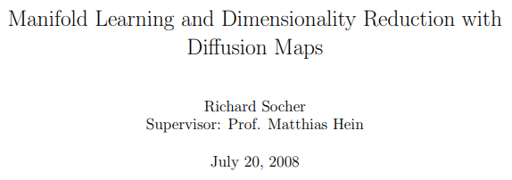
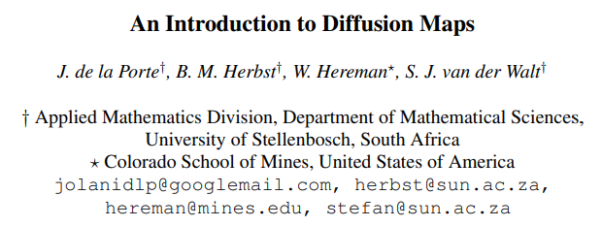

Slide 3
Outline
PCA
Local Linear Embedding
MDS
Isomap
Laplacian Eigenmaps
Diffusion Maps

Slide 4
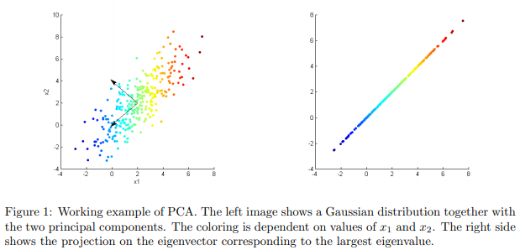
PCA

Slide 5
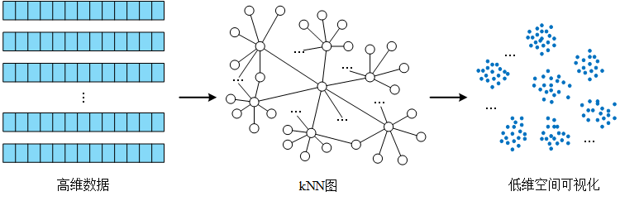
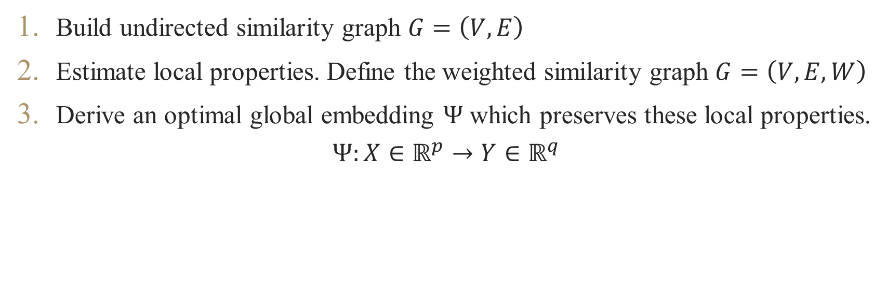



Graph-Based Algorithms
Build undirected similarity graph $G=\left(V,E\right)$
Estimate local properties. Define the weighted similarity graph $G=\left(V,E,W\right)$
Derive an optimal global embedding $Ψ$ which preserves these local properties.
$$Ψ:X∈ℝ^{p}→Y∈ℝ^{q}$$
$$X=$$
$$G=\left(V,E,W\right)$$
$$=Y$$

Slide 6





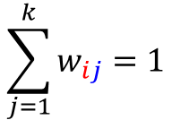









Local Linear Embedding LLE
$$\sum_{j=1}^{k}{w_{ij}}=1$$
$$X_{i}$$
$$η_{i1}$$
$$η_{\text{i}6}$$
$$w_{i6}$$
$$w_{i1}$$
$$η_{i2}$$
$$w_{i5}$$
$$X_{i}$$
$$w_{i2}$$
$$η_{\text{i}5}$$
$$w_{i4}$$
$$w_{i3}$$
$$η_{i4}$$
$$η_{i3}$$

Slide 7
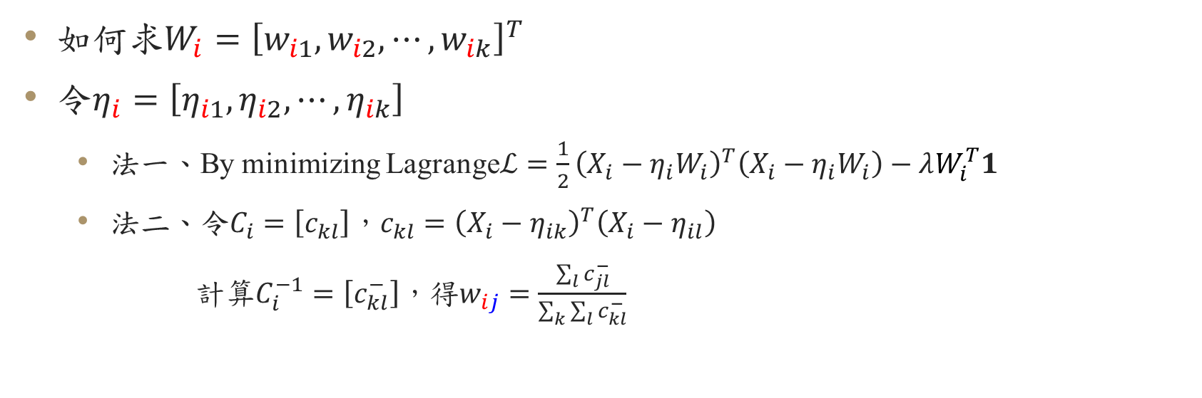
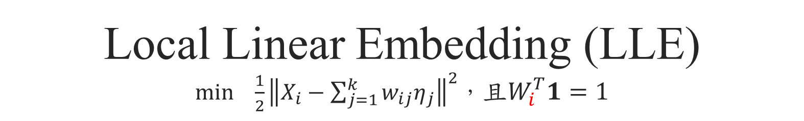
Local Linear Embedding (LLE) $\min_{}{\frac{1}{2}}{\left\|X_{i}−\sum_{j=1}^{k}{w_{ij}η_{j}}\right\|}^{2}$，且$W_{i}^{T}1=1$
如何求$W_{i}={\left[w_{i1},w_{i2},⋯,w_{ik}\right]}^{T}$
令$η_{i}=\left[η_{i1},η_{i2},⋯,η_{ik}\right]$
法一、By minimizing Lagrange$ℒ=\frac{1}{2}{\left(X_{i}−η_{i}W_{i}\right)}^{T}\left(X_{i}−η_{i}W_{i}\right)−λW_{i}^{T}1$
法二、令$C_{i}=\left[c_{kl}\right]$，$c_{kl}={\left(X_{i}−η_{ik}\right)}^{T}\left(X_{i}−η_{il}\right)$
計算$C_{i}^{−1}=\left[c_{kl}^{−}\right]$，得$w_{ij}=\frac{\sum_{l}{c_{jl}^{−}}}{\sum_{k}{\sum_{l}{c_{kl}^{−}}}}$

Slide 8
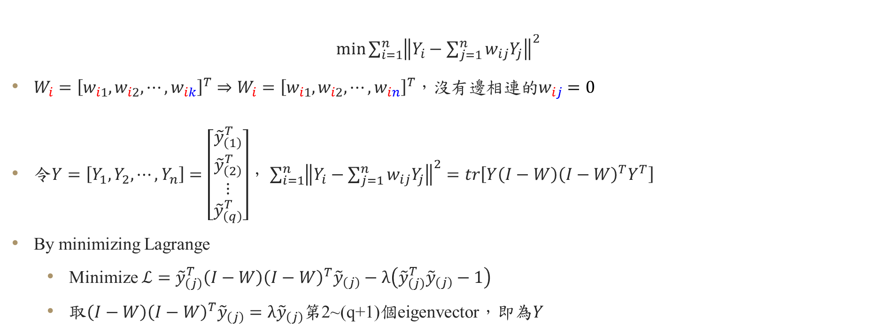
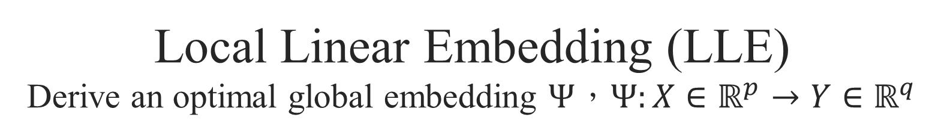
Local Linear Embedding (LLE) Derive an optimal global embedding $Ψ$，$Ψ:X∈ℝ^{p}→Y∈ℝ^{q}$
$\min_{}{\sum_{i=1}^{n}{{\left\|Y_{i}−\sum_{j=1}^{n}{w_{ij}Y_{j}}\right\|}^{2}}}$
$W_{i}={\left[w_{i1},w_{i2},⋯,w_{ik}\right]}^{T}⇒W_{i}={\left[w_{i1},w_{i2},⋯,w_{in}\right]}^{T}$，沒有邊相連的$w_{ij}=0$
令$Y=\left[Y_{1},Y_{2},⋯,Y_{n}\right]=\left[\begin{aligned}{\tilde{y}}_{\left(1\right)}^{T} \\ {\tilde{y}}_{\left(2\right)}^{T} \\ ⋮ \\ {\tilde{y}}_{\left(q\right)}^{T}\end{aligned}\right]$， $\sum_{i=1}^{n}{{\left\|Y_{i}−\sum_{j=1}^{n}{w_{ij}Y_{j}}\right\|}^{2}}=tr\left[Y\left(I−W\right){\left(I−W\right)}^{T}Y^{T}\right]$
By minimizing Lagrange
Minimize $ℒ={\tilde{y}}_{\left(j\right)}^{T}\left(I−W\right){\left(I−W\right)}^{T}{\tilde{y}}_{\left(j\right)}−λ\left({\tilde{y}}_{\left(j\right)}^{T}{\tilde{y}}_{\left(j\right)}−1\right)$
取$\left(I−W\right){\left(I−W\right)}^{T}{\tilde{y}}_{\left(j\right)}=λ{\tilde{y}}_{\left(j\right)}$第2~(q+1)個eigenvector，即為$Y$

Slide 9

Local Linear Embedding LLE
取得local properties，$G=\left(V,E,W\right)$
對於$X_{i}$，估計$W_{i}$，且$W_{i}^{T}1=1$
利用$W$，找到$Y_{1},Y_{2},⋯,Y_{n}$，使得$\sum_{i=1}^{n}{{\left\|Y_{i}−\sum_{j=1}^{n}{w_{ij}Y_{j}}\right\|}^{2}}$最小

Slide 10
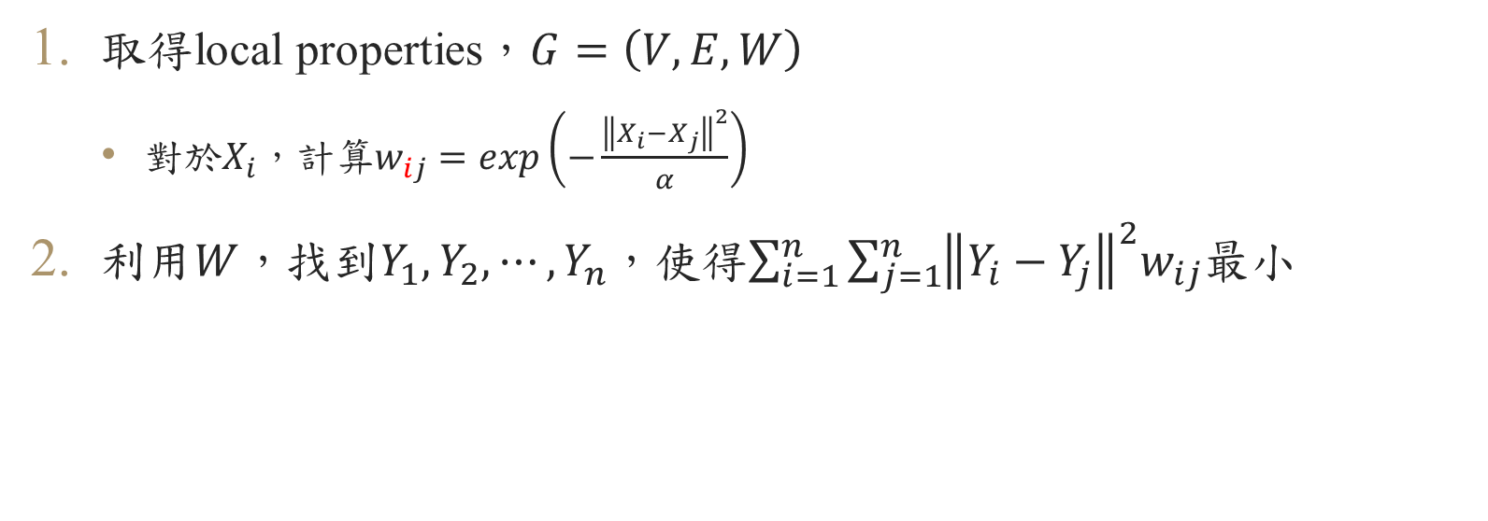
Laplacian Eigenmaps LE
取得local properties，$G=\left(V,E,W\right)$
對於$X_{i}$，計算$w_{ij}=exp\left(−\frac{{\left\|X_{i}−X_{j}\right\|}^{2}}{α}\right)$
利用$W$，找到$Y_{1},Y_{2},⋯,Y_{n}$，使得$\sum_{i=1}^{n}{\sum_{j=1}^{n}{{\left\|Y_{i}−Y_{j}\right\|}^{2}w_{ij}}}$最小

Slide 11
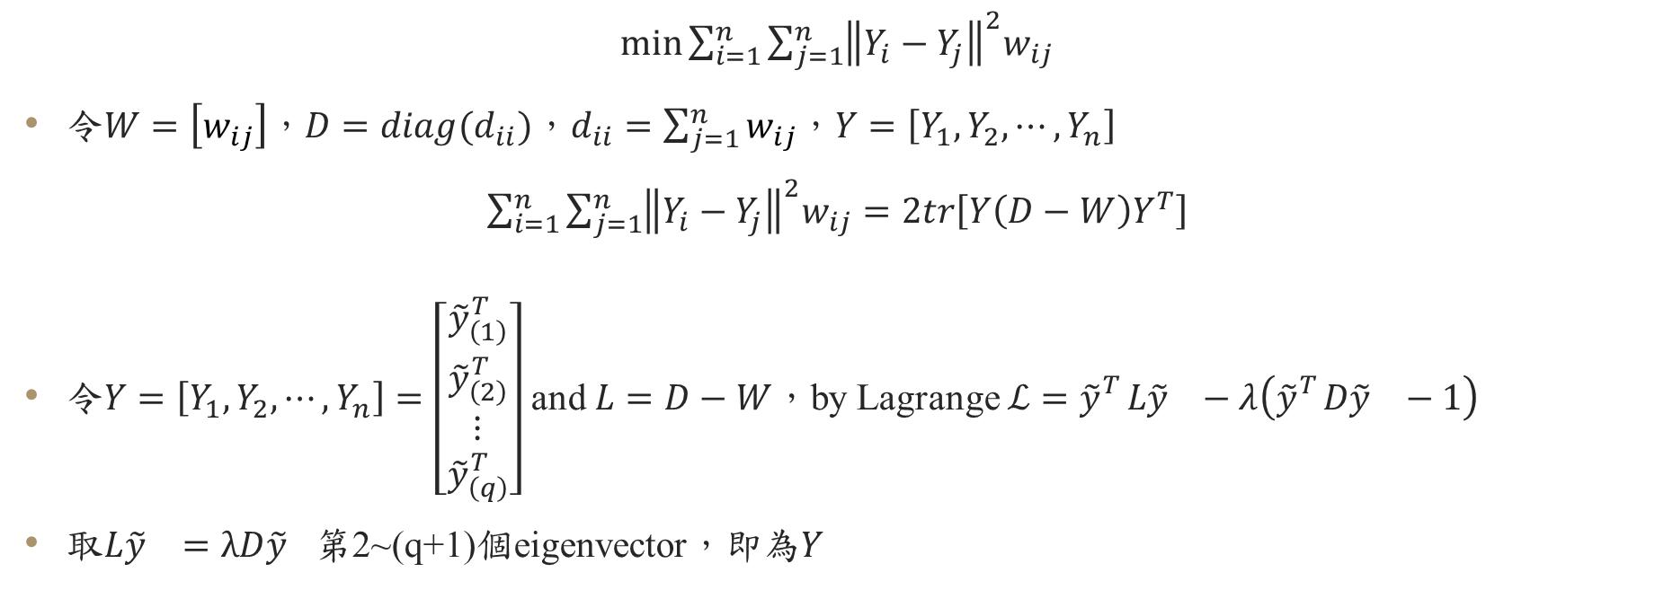
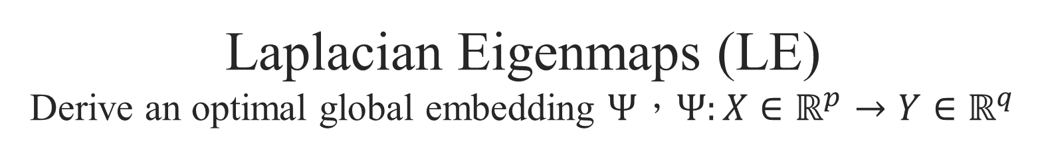
Laplacian Eigenmaps (LE) Derive an optimal global embedding $Ψ$，$Ψ:X∈ℝ^{p}→Y∈ℝ^{q}$
$\min_{}{\sum_{i=1}^{n}{\sum_{j=1}^{n}{{\left\|Y_{i}−Y_{j}\right\|}^{2}w_{ij}}}}$
令$W=\left[w_{ij}\right]$，$D=diag(d_{ii})$，$d_{ii}=\sum_{j=1}^{n}{w_{ij}}$，$Y=\left[Y_{1},Y_{2},⋯,Y_{n}\right]$
$\sum_{i=1}^{n}{\sum_{j=1}^{n}{{\left\|Y_{i}−Y_{j}\right\|}^{2}w_{ij}}}=2tr\left[Y\left(D−W\right)Y^{T}\right]$
令$Y=\left[Y_{1},Y_{2},⋯,Y_{n}\right]=\left[\begin{aligned}{\tilde{y}}_{\left(1\right)}^{T} \\ {\tilde{y}}_{\left(2\right)}^{T} \\ ⋮ \\ {\tilde{y}}_{\left(q\right)}^{T}\end{aligned}\right]$ and $L=D−W$，by Lagrange $ℒ={\tilde{y}}_{}^{T}L{\tilde{y}}_{}−λ\left({\tilde{y}}_{}^{T}D{\tilde{y}}_{}−1\right)$
取$L{\tilde{y}}_{}=λD{\tilde{y}}_{}$第2~(q+1)個eigenvector，即為$Y$

Slide 12
Diffusion Map

Slide 13
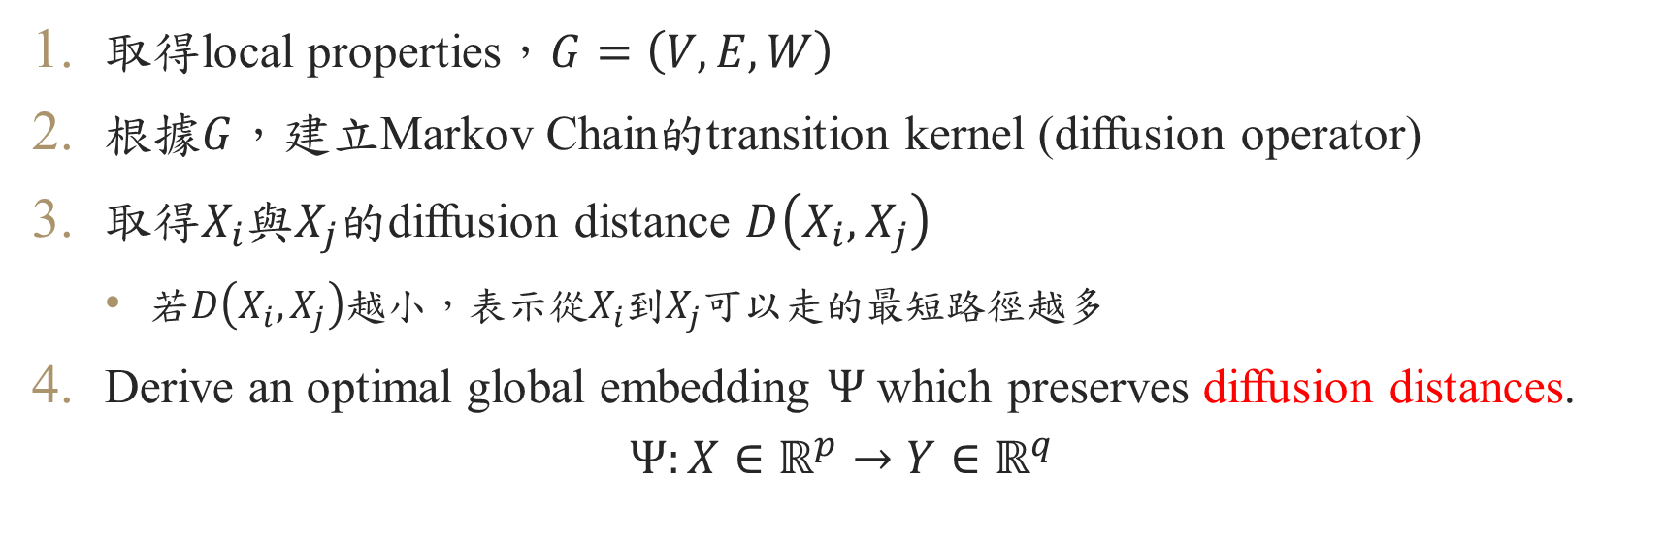
Diffusion Map
取得local properties，$G=\left(V,E,W\right)$
根據$G$，建立Markov Chain的transition kernel (diffusion operator)
取得$X_{i}$與$X_{j}$的diffusion distance $D\left(X_{i},X_{j}\right)$
若$D\left(X_{i},X_{j}\right)$越小，表示從$X_{i}$到$X_{j}$可以走的最短路徑越多
Derive an optimal global embedding $Ψ$ which preserves diffusion distances.
$$Ψ:X∈ℝ^{p}→Y∈ℝ^{q}$$

Slide 15
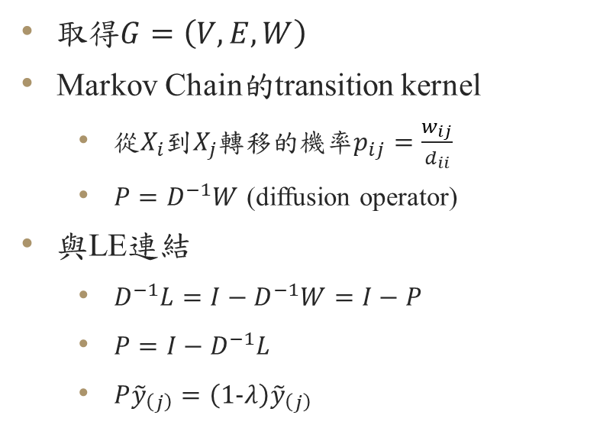
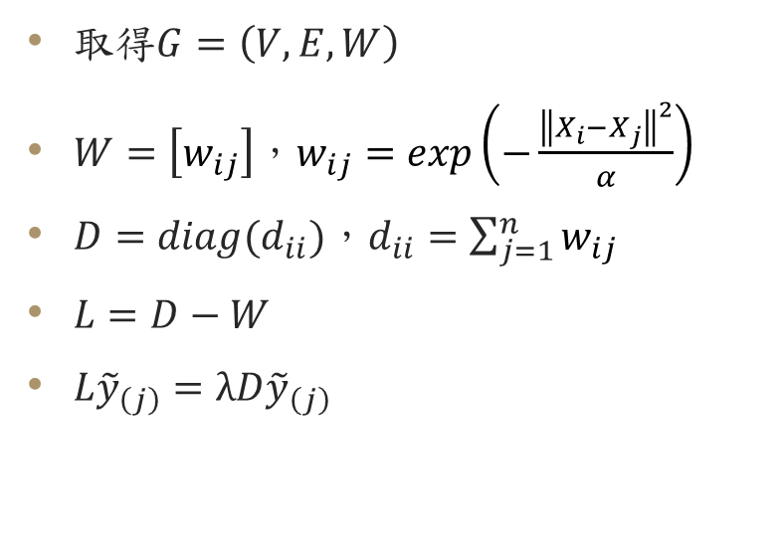
Laplacian Eigenmaps
Diffusion Map 初始想法
取得$G=\left(V,E,W\right)$
$W=\left[w_{ij}\right]$，$w_{ij}=exp\left(−\frac{{\left\|X_{i}−X_{j}\right\|}^{2}}{α}\right)$
$D=diag(d_{ii})$，$d_{ii}=\sum_{j=1}^{n}{w_{ij}}$
$L=D−W$
$L{\tilde{y}}_{\left(j\right)}=λD{\tilde{y}}_{\left(j\right)}$
取得$G=\left(V,E,W\right)$
Markov Chain的transition kernel
從$X_{i}$到$X_{j}$轉移的機率$p_{ij}=\frac{w_{ij}}{d_{ii}}$
$P=D^{−1}W$ (diffusion operator)
與LE連結
$D^{−1}L=I−D^{−1}W=I−P$
$P=I−D^{−1}L$
$P{\tilde{y}}_{\left(j\right)}=\left(1−λ\right){\tilde{y}}_{\left(j\right)}$
從第2小的eigenvector開始收集
從第2大的eigenvector開始收集

Slide 16
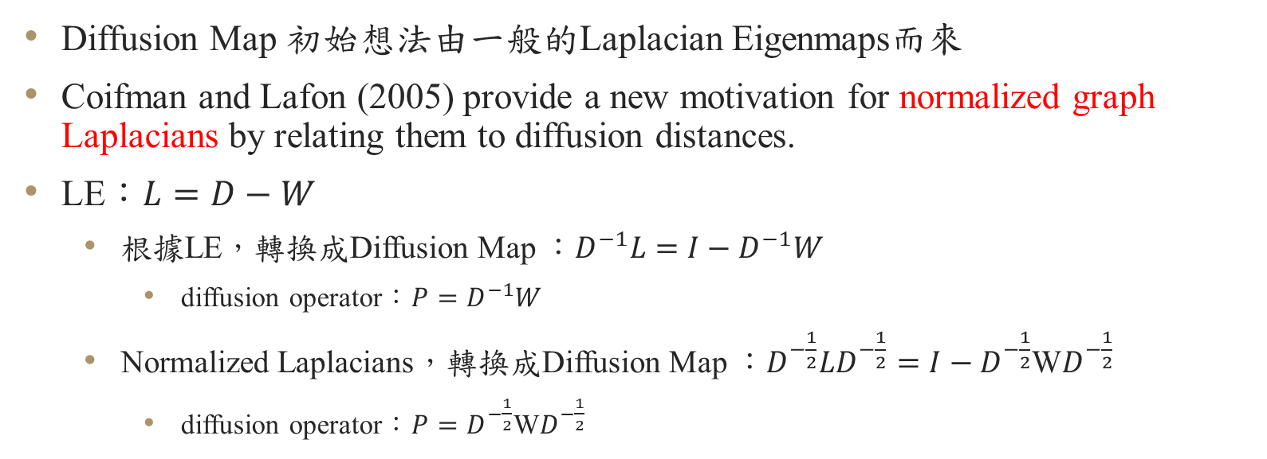
Diffusion Map 正式版
Diffusion Map 初始想法由一般的Laplacian Eigenmaps而來
Coifman and Lafon (2005) provide a new motivation for normalized graph Laplacians by relating them to diffusion distances.
LE：$L=D−W$
根據LE，轉換成Diffusion Map ：$D^{−1}L=I−D^{−1}W$
diffusion operator：$P=D^{−1}W$
Normalized Laplacians，轉換成Diffusion Map ：$D^{−\frac{1}{2}}LD^{−\frac{1}{2}}=I−D^{−\frac{1}{2}}$W$D^{−\frac{1}{2}}$
diffusion operator：$P=D^{−\frac{1}{2}}\text{W}D^{−\frac{1}{2}}$

Slide 17

Diffusion Map 正式版
Normalized LE，Diffusion operator：$P=D^{−\frac{1}{2}}\text{W}D^{−\frac{1}{2}}$
$$P=\sum_{j=1}^{q}{λ_{j}^{2}}φ_{j}φ_{j}^{T}$$
$Y=\left[Y_{1},Y_{2},⋯,Y_{n}\right]=\left[\begin{aligned}{\tilde{y}}_{\left(1\right)}^{T} \\ {\tilde{y}}_{\left(2\right)}^{T} \\ ⋮ \\ {\tilde{y}}_{\left(q\right)}^{T}\end{aligned}\right]=\left[\begin{aligned}λ_{1}φ_{1}^{T} \\ λ_{2}φ_{2}^{T} \\ ⋮ \\ λ_{q}φ_{q}^{T}\end{aligned}\right]$
從第1大的eigenvector開始收集

Slide 18
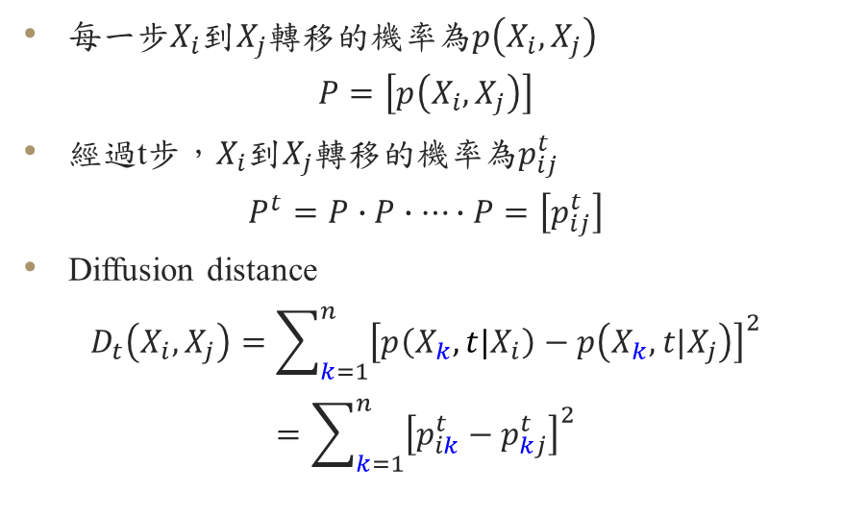
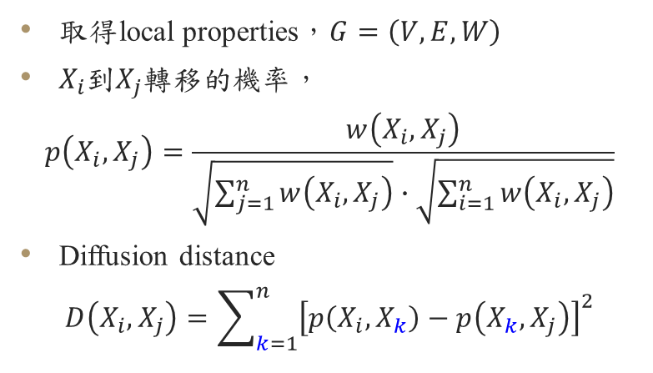
Diffusion Map (Extend)
1 step
t steps
取得local properties，$G=\left(V,E,W\right)$
$X_{i}$到$X_{j}$轉移的機率，
$$p\left(X_{i},X_{j}\right)=\frac{w\left(X_{i},X_{j}\right)}{\sqrt{\sum_{j=1}^{n}{w\left(X_{i},X_{j}\right)}}∙\sqrt{\sum_{i=1}^{n}{w\left(X_{i},X_{j}\right)}}}$$
Diffusion distance
$$D\left(X_{i},X_{j}\right)=\sum_{k=1}^{n}{{\left[p\left(X_{i},X_{k}\right)−p\left(X_{k},X_{j}\right)\right]}^{2}}$$
每一步$X_{i}$到$X_{j}$轉移的機率為$p\left(X_{i},X_{j}\right)$
$$P=\left[p\left(X_{i},X_{j}\right)\right]$$
經過t步，$X_{i}$到$X_{j}$轉移的機率為$p_{ij}^{t}$
$$P^{t}=P∙P∙⋯∙P=\left[p_{ij}^{t}\right]$$
Diffusion distance
$$D_{t}\left(X_{i},X_{j}\right)=\sum_{k=1}^{n}{{\left[p\left(X_{k},t|X_{i}\right)−p\left(X_{k},t|X_{j}\right)\right]}^{2}}$$
$$=\sum_{k=1}^{n}{{\left[p_{ik}^{t}−p_{kj}^{t}\right]}^{2}}$$

Slide 19
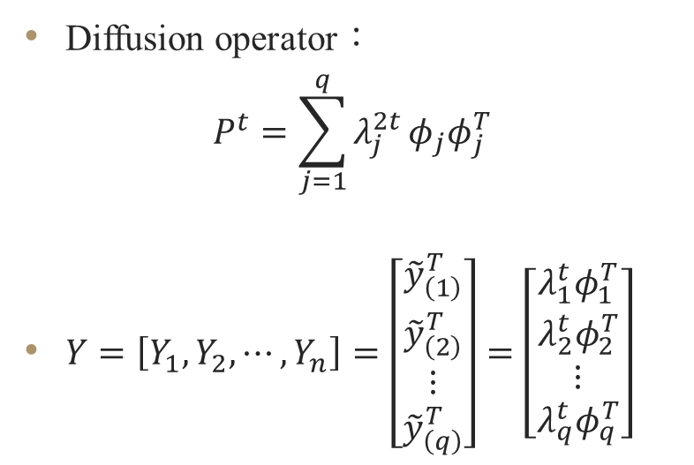
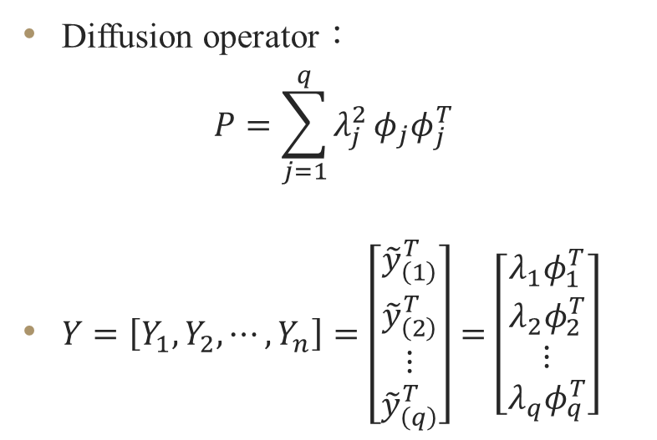
Diffusion Map (Extend)
1 step
t steps
Diffusion operator：
$$P=\sum_{j=1}^{q}{λ_{j}^{2}}φ_{j}φ_{j}^{T}$$
$Y=\left[Y_{1},Y_{2},⋯,Y_{n}\right]=\left[\begin{aligned}{\tilde{y}}_{\left(1\right)}^{T} \\ {\tilde{y}}_{\left(2\right)}^{T} \\ ⋮ \\ {\tilde{y}}_{\left(q\right)}^{T}\end{aligned}\right]=\left[\begin{aligned}λ_{1}φ_{1}^{T} \\ λ_{2}φ_{2}^{T} \\ ⋮ \\ λ_{q}φ_{q}^{T}\end{aligned}\right]$
Diffusion operator：
$$P^{t}=\sum_{j=1}^{q}{λ_{j}^{2t}}φ_{j}φ_{j}^{T}$$
$Y=\left[Y_{1},Y_{2},⋯,Y_{n}\right]=\left[\begin{aligned}{\tilde{y}}_{\left(1\right)}^{T} \\ {\tilde{y}}_{\left(2\right)}^{T} \\ ⋮ \\ {\tilde{y}}_{\left(q\right)}^{T}\end{aligned}\right]=\left[\begin{aligned}λ_{1}^{t}φ_{1}^{T} \\ λ_{2}^{t}φ_{2}^{T} \\ ⋮ \\ λ_{q}^{t}φ_{q}^{T}\end{aligned}\right]$

Slide 20
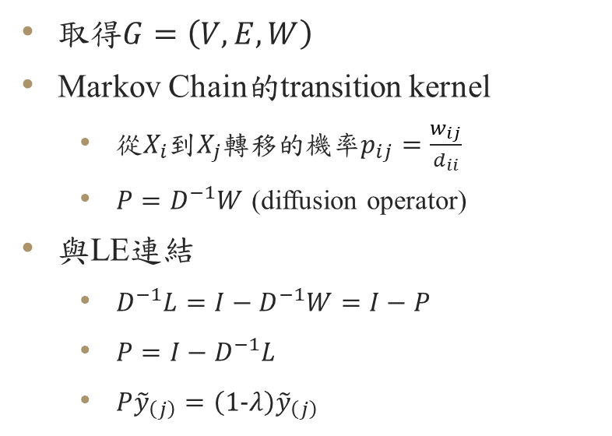
取得$G=\left(V,E,W\right)$
Markov Chain的transition kernel
從$X_{i}$到$X_{j}$轉移的機率$p_{ij}=\frac{w_{ij}}{d_{ii}}$
$P=D^{−1}W$ (diffusion operator)
與LE連結
$D^{−1}L=I−D^{−1}W=I−P$
$P=I−D^{−1}L$
$P{\tilde{y}}_{\left(j\right)}=\left(1−λ\right){\tilde{y}}_{\left(j\right)}$
Diffusion Map 初始想法
從第2大的eigenvector開始收集

Slide 21
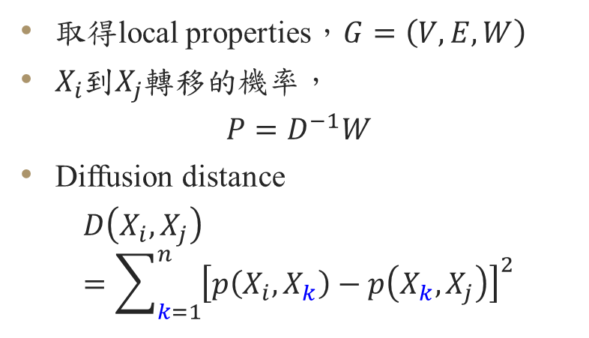
Diffusion Map (Extend)
1 step
t steps
取得local properties，$G=\left(V,E,W\right)$
$X_{i}$到$X_{j}$轉移的機率，
$$P=D^{−1}W$$
Diffusion distance
$$D\left(X_{i},X_{j}\right)=\sum_{k=1}^{n}{{\left[p\left(X_{i},X_{k}\right)−p\left(X_{k},X_{j}\right)\right]}^{2}}$$
每一步$X_{i}$到$X_{j}$轉移的機率為$p\left(X_{i},X_{j}\right)$
$$P=\left[p\left(X_{i},X_{j}\right)\right]$$
經過t步，$X_{i}$到$X_{j}$轉移的機率為$p_{ij}^{t}$
$$P^{t}=P∙P∙⋯∙P=\left[p_{ij}^{t}\right]$$
Diffusion distance
$$D_{t}\left(X_{i},X_{j}\right)=\sum_{k=1}^{n}{{\left[p\left(X_{k},t|X_{i}\right)−p\left(X_{k},t|X_{j}\right)\right]}^{2}}$$
$$=\sum_{k=1}^{n}{{\left[p_{ik}^{t}−p_{kj}^{t}\right]}^{2}}$$

Slide 22
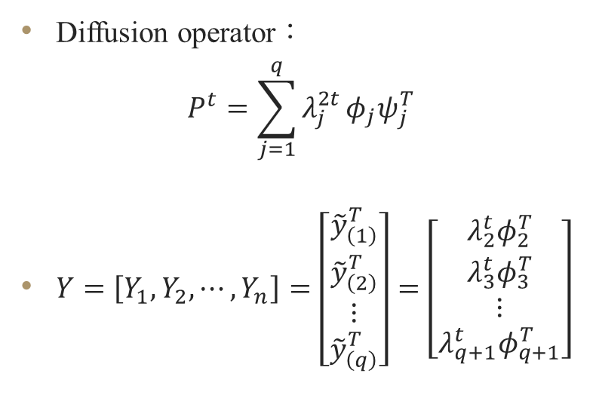
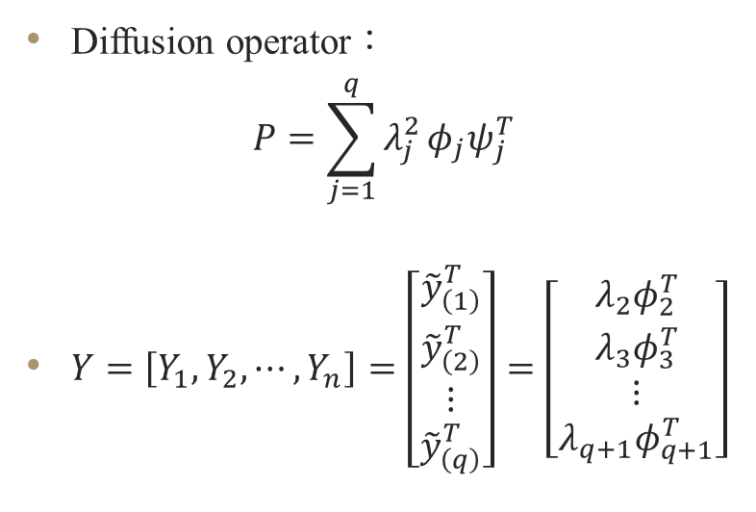
Diffusion Map (Extend)
1 step
t steps
Diffusion operator：
$$P=\sum_{j=1}^{q}{λ_{j}^{2}}φ_{j}ψ_{j}^{T}$$
$Y=\left[Y_{1},Y_{2},⋯,Y_{n}\right]=\left[\begin{aligned}{\tilde{y}}_{\left(1\right)}^{T} \\ {\tilde{y}}_{\left(2\right)}^{T} \\ ⋮ \\ {\tilde{y}}_{\left(q\right)}^{T}\end{aligned}\right]=\left[\begin{aligned}λ_{2}φ_{2}^{T} \\ λ_{3}φ_{3}^{T} \\ ⋮ \\ λ_{q+1}φ_{q+1}^{T}\end{aligned}\right]$
Diffusion operator：
$$P^{t}=\sum_{j=1}^{q}{λ_{j}^{2t}}φ_{j}ψ_{j}^{T}$$
$Y=\left[Y_{1},Y_{2},⋯,Y_{n}\right]=\left[\begin{aligned}{\tilde{y}}_{\left(1\right)}^{T} \\ {\tilde{y}}_{\left(2\right)}^{T} \\ ⋮ \\ {\tilde{y}}_{\left(q\right)}^{T}\end{aligned}\right]=\left[\begin{aligned}λ_{2}^{t}φ_{2}^{T} \\ λ_{3}^{t}φ_{3}^{T} \\ ⋮ \\ λ_{q+1}^{t}φ_{q+1}^{T}\end{aligned}\right]$

Slide 23
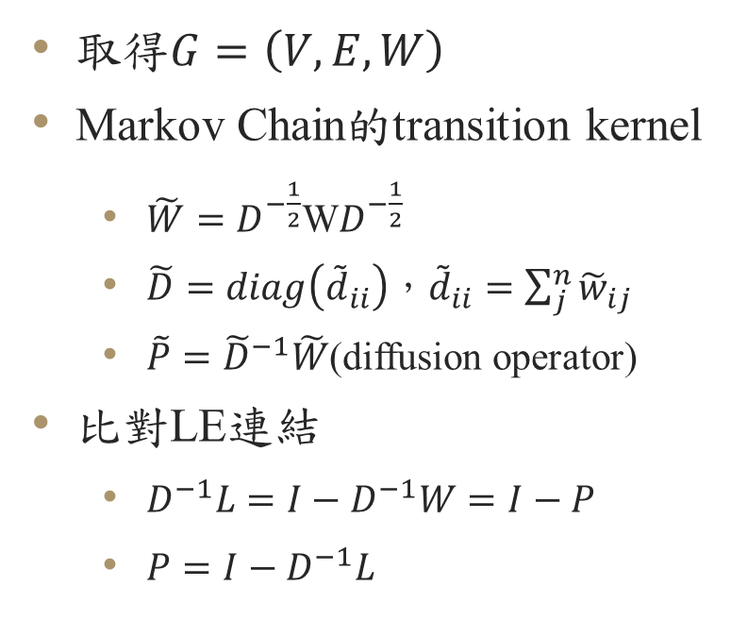
取得$G=\left(V,E,W\right)$
Markov Chain的transition kernel
$\tilde{W}=D^{−\frac{1}{2}}\text{W}D^{−\frac{1}{2}}$
$\tilde{D}=diag\left({\tilde{d}}_{ii}\right)$，${\tilde{d}}_{ii}=\sum_{j}^{n}{{\tilde{w}}_{ij}}$
$\tilde{P}={\tilde{D}}^{−1}\tilde{W}$(diffusion operator)
比對LE連結
$D^{−1}L=I−D^{−1}W=I−P$
$P=I−D^{−1}L$
同時結合
初始想法+正式版
從第2大的eigenvector開始收集

Slide 24
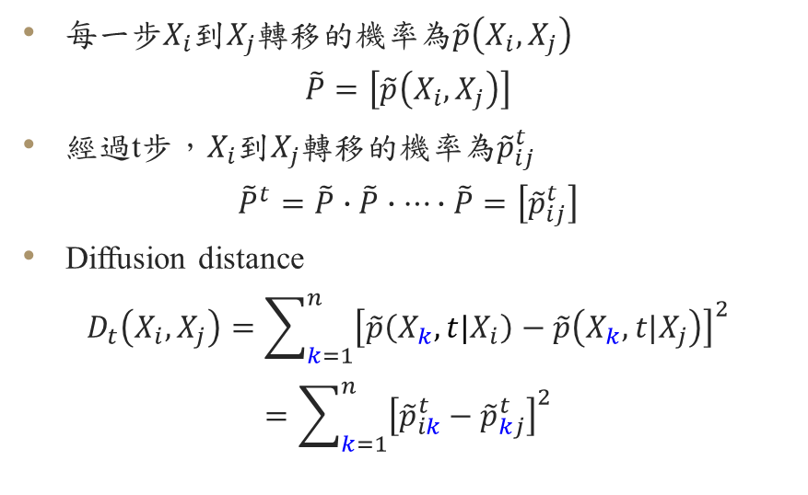
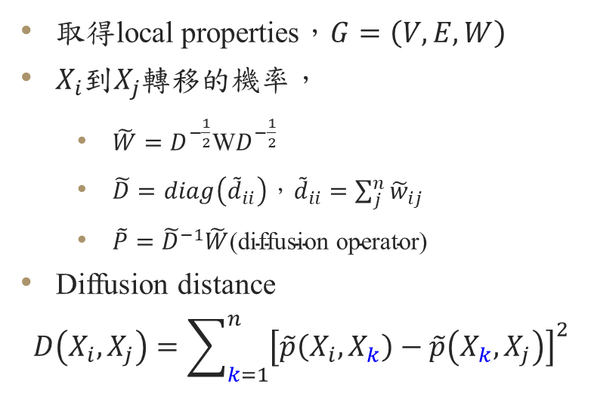
Diffusion Map (Extend)
1 step
t steps
取得local properties，$G=\left(V,E,W\right)$
$X_{i}$到$X_{j}$轉移的機率，
$\tilde{W}=D^{−\frac{1}{2}}\text{W}D^{−\frac{1}{2}}$
$\tilde{D}=diag\left({\tilde{d}}_{ii}\right)\text{，}{\tilde{d}}_{ii}=\sum_{j}^{n}{{\tilde{w}}_{ij}}$
$\tilde{P}={\tilde{D}}^{−1}\tilde{W}\text{(}\text{diffusion} \text{operator}\text{)}$
Diffusion distance
$$D\left(X_{i},X_{j}\right)=\sum_{k=1}^{n}{{\left[\tilde{p}\left(X_{i},X_{k}\right)−\tilde{p}\left(X_{k},X_{j}\right)\right]}^{2}}$$
每一步$X_{i}$到$X_{j}$轉移的機率為$\tilde{p}\left(X_{i},X_{j}\right)$
$$\tilde{P}=\left[\tilde{p}\left(X_{i},X_{j}\right)\right]$$
經過t步，$X_{i}$到$X_{j}$轉移的機率為${\tilde{p}}_{ij}^{t}$
$${\tilde{P}}^{t}=\tilde{P}∙\tilde{P}∙⋯∙\tilde{P}=\left[{\tilde{p}}_{ij}^{t}\right]$$
Diffusion distance
$$D_{t}\left(X_{i},X_{j}\right)=\sum_{k=1}^{n}{{\left[\tilde{p}\left(X_{k},t|X_{i}\right)−\tilde{p}\left(X_{k},t|X_{j}\right)\right]}^{2}}$$
$$=\sum_{k=1}^{n}{{\left[{\tilde{p}}_{ik}^{t}−{\tilde{p}}_{kj}^{t}\right]}^{2}}$$

Slide 25
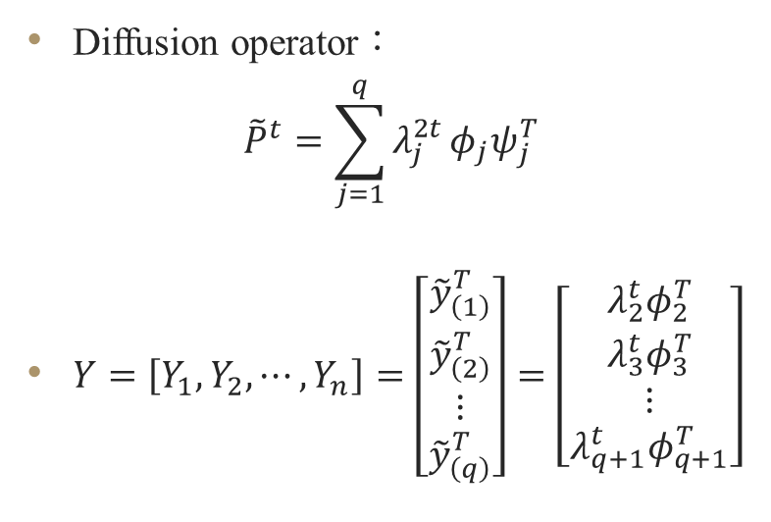

Diffusion Map (Extend)
1 step
t steps
Diffusion operator：
$$\tilde{P}=\sum_{j=1}^{q}{λ_{j}^{2}}φ_{j}ψ_{j}^{T}$$
$Y=\left[Y_{1},Y_{2},⋯,Y_{n}\right]=\left[\begin{aligned}{\tilde{y}}_{\left(1\right)}^{T} \\ {\tilde{y}}_{\left(2\right)}^{T} \\ ⋮ \\ {\tilde{y}}_{\left(q\right)}^{T}\end{aligned}\right]=\left[\begin{aligned}λ_{2}φ_{2}^{T} \\ λ_{3}φ_{3}^{T} \\ ⋮ \\ λ_{q+1}φ_{q+1}^{T}\end{aligned}\right]$
Diffusion operator：
$${\tilde{P}}^{t}=\sum_{j=1}^{q}{λ_{j}^{2t}}φ_{j}ψ_{j}^{T}$$
$Y=\left[Y_{1},Y_{2},⋯,Y_{n}\right]=\left[\begin{aligned}{\tilde{y}}_{\left(1\right)}^{T} \\ {\tilde{y}}_{\left(2\right)}^{T} \\ ⋮ \\ {\tilde{y}}_{\left(q\right)}^{T}\end{aligned}\right]=\left[\begin{aligned}λ_{2}^{t}φ_{2}^{T} \\ λ_{3}^{t}φ_{3}^{T} \\ ⋮ \\ λ_{q+1}^{t}φ_{q+1}^{T}\end{aligned}\right]$

Slide 26
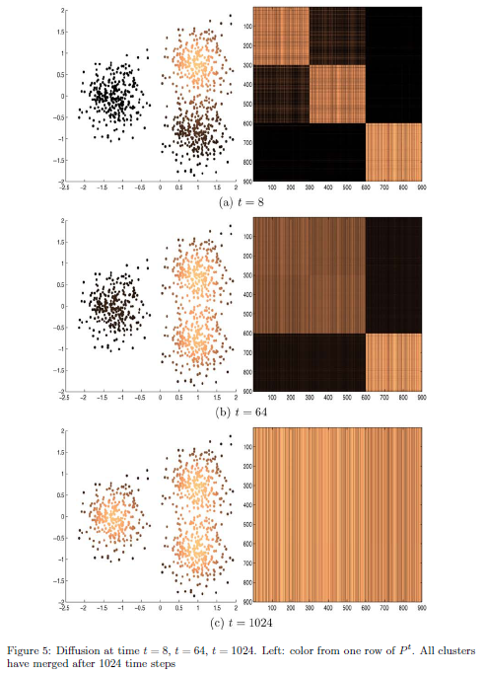

Diffusion Map 應用
Construct similarity graph
Compute normalized Laplacian
Define the embedding $Y_{i}$ via diffusion maps
Cluster points $Y_{i}∈ℝ^{q}$ with k-means

Slide 27
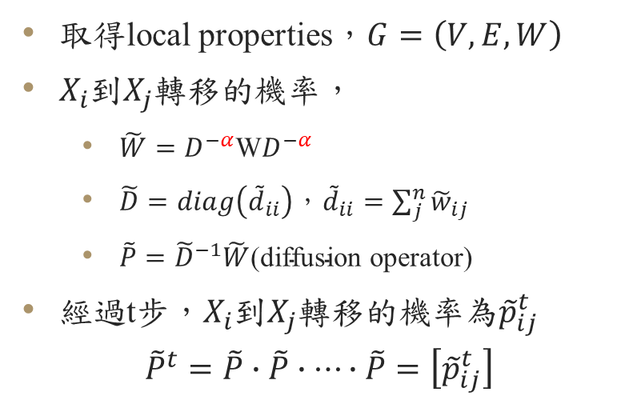
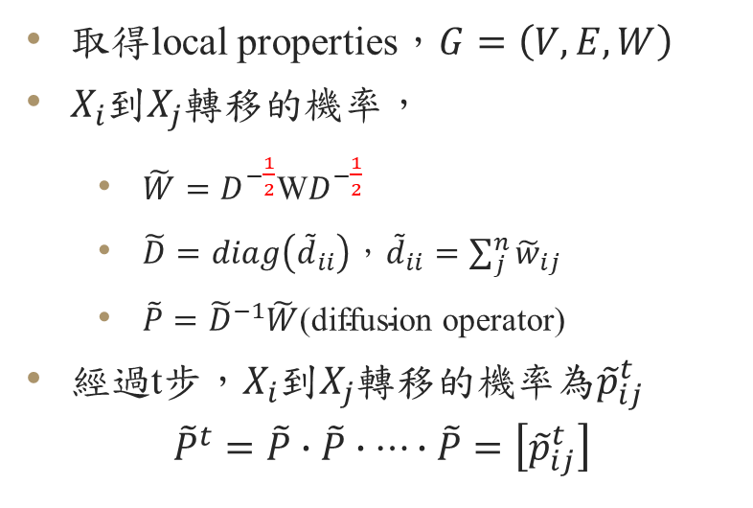
Anisotropic Diffusions
Diffusions
Anisotropic Diffusions
取得local properties，$G=\left(V,E,W\right)$
$X_{i}$到$X_{j}$轉移的機率，
$\tilde{W}=D^{−\frac{1}{2}}\text{W}D^{−\frac{1}{2}}$
$\tilde{D}=diag\left({\tilde{d}}_{ii}\right)\text{，}{\tilde{d}}_{ii}=\sum_{j}^{n}{{\tilde{w}}_{ij}}$
$\tilde{P}={\tilde{D}}^{−1}\tilde{W}\text{(}\text{diffusion} \text{operator}\text{)}$
經過t步，$X_{i}$到$X_{j}$轉移的機率為${\tilde{p}}_{ij}^{t}$
$${\tilde{P}}^{t}=\tilde{P}∙\tilde{P}∙⋯∙\tilde{P}=\left[{\tilde{p}}_{ij}^{t}\right]$$
取得local properties，$G=\left(V,E,W\right)$
$X_{i}$到$X_{j}$轉移的機率，
$\tilde{W}=D^{−α}\text{W}D^{−α}$
$\tilde{D}=diag\left({\tilde{d}}_{ii}\right)\text{，}{\tilde{d}}_{ii}=\sum_{j}^{n}{{\tilde{w}}_{ij}}$
$\tilde{P}={\tilde{D}}^{−1}\tilde{W}\text{(}\text{diffusion} \text{operator}\text{)}$
經過t步，$X_{i}$到$X_{j}$轉移的機率為${\tilde{p}}_{ij}^{t}$
$${\tilde{P}}^{t}=\tilde{P}∙\tilde{P}∙⋯∙\tilde{P}=\left[{\tilde{p}}_{ij}^{t}\right]$$

Slide 28
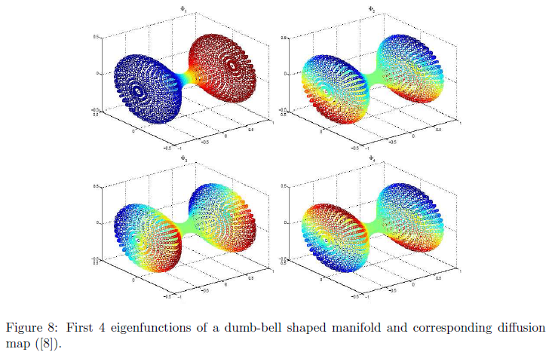

Slide 29
The End

